Slide 1

Dynamics, Mechanisms, and Surrogate Modelling,
of
Noise from a Leading Edge Slat
Laboratoire de Mécanique des Fluides et d'Acoustique - UMR 5509
Candidate:
Amal Roy Murali*
PhD Defense
Jury:
Benjamin Cotté (IMSIA, rapporteur)
Florent Margnat (Institut P’, rapporteur)
Anita Schulz (HTW Berlin)
Emmanuel Lévêque (LMFA)
Florian Guiho (Airbus, invité)
Supervisors:
Marc Jacob (LMFA, Directeur de thèse)
Vincent Clair (LMFA, Co-encadrant)
Michel Roger (LMFA, Co-encadrant)
6th June 2025

Slide 2
Outline
ECL Thesis – Started on December 15th 2021
Themes:
Aero-acoustic Surrogate Modelling
Coupling Aeroacoustic simulations with Bayesian Active Learning
Slat flow and noise investigation using ProLB (LBM)
Parametric simulations, Cove vortex behaviour
Structure of the talk
Introduction
ProLB for slat aeroacoustics - Computation/Validation
Bayesian Surrogate Model
Slat cove Dynamics
Vorticity transition on curved shear layer
Thesis contributions and Future Perspective

Slide 3
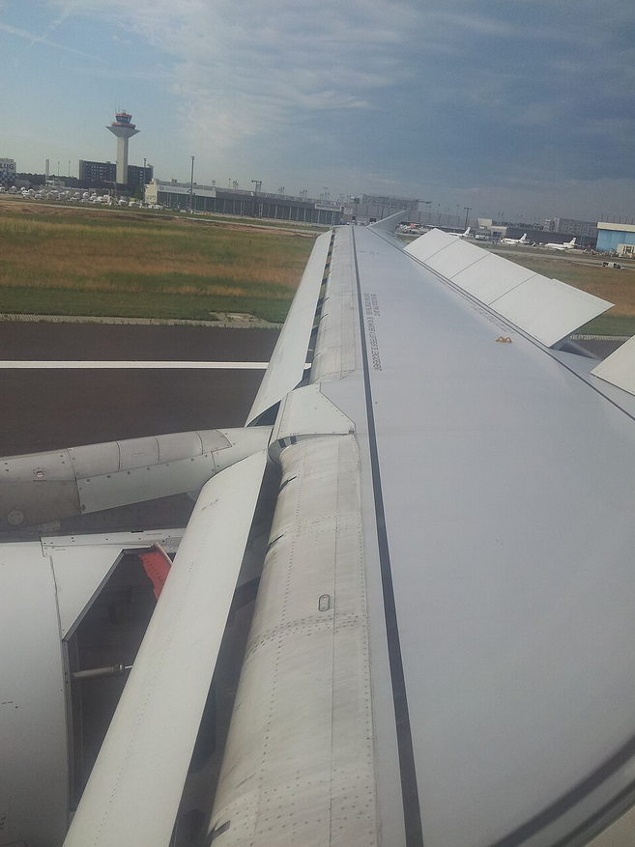
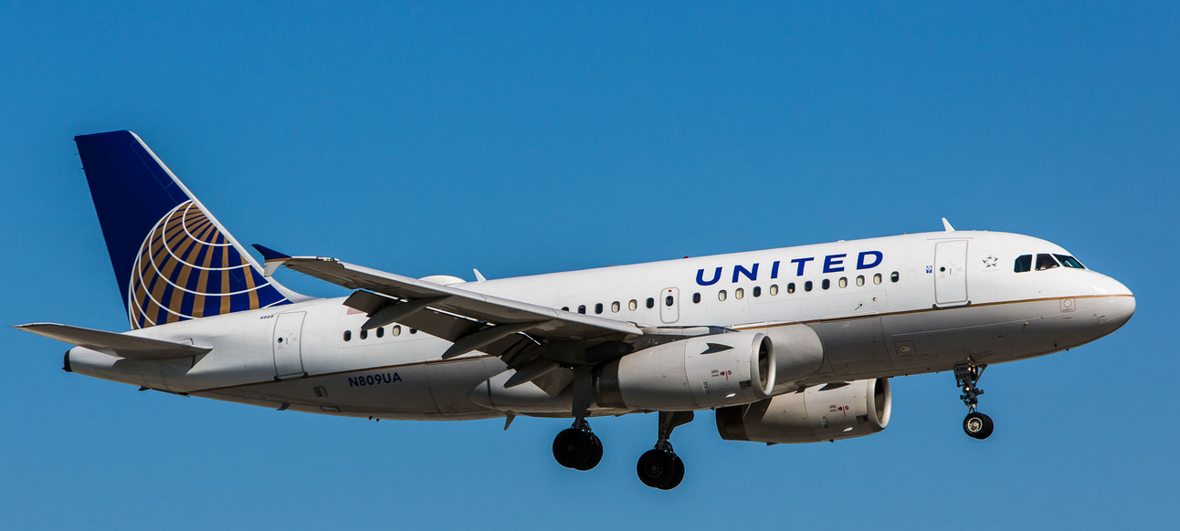
Introduction
A319 with Leading Edge (LE) slat deployed before landing
Slat device in an Airbus A319
1

Slide 4
Introduction
A319 with Leading Edge (LE) slat deployed before landing
10 dB noisier with slat deployed
~ W. Dobrzynski (2010)
Slat device in an Airbus A319
1

Slide 5
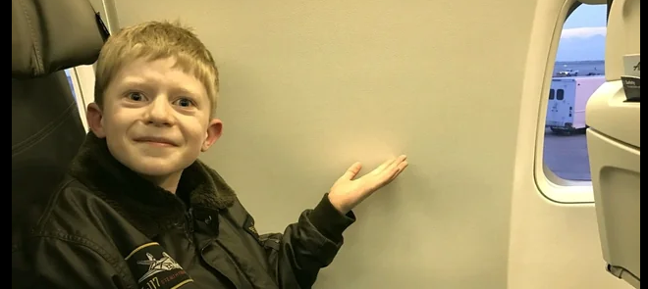
Introduction
A319 with LE slat deployed before landing
Slat device in an Airbus A319
S/N: 1

Slide 6
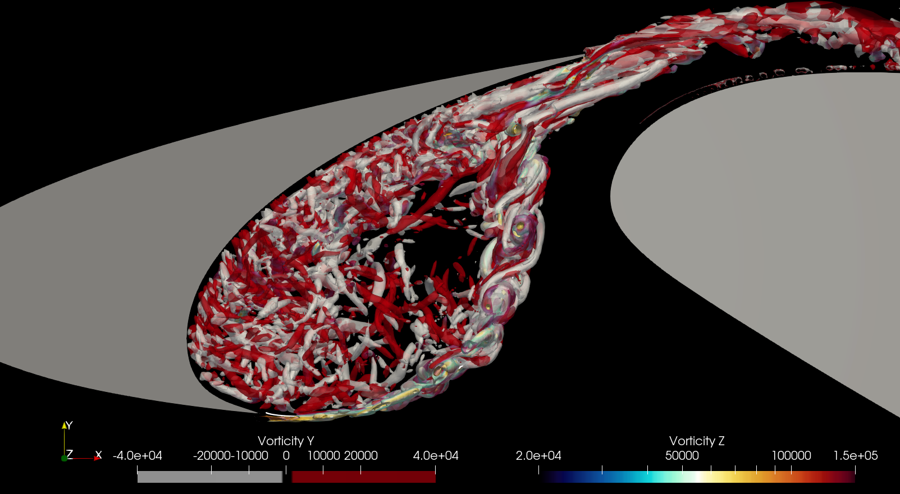
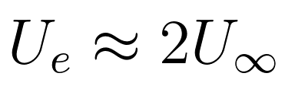
Introduction
Main flow features:
Turbulence ejection
High speed ejection
Spanwise + Streamwise vorticity
Quasiperiodic
Trailing Edge (TE)
1
Wing
Slat
Cusp
Above: Vortices in a slat cove visualised using ProLB simulation
2

Slide 7
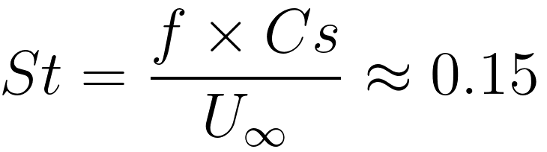
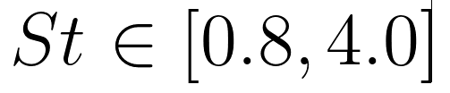
Introduction
Main flow features:
Turbulence ejection
Recirculation
Closed loop vortex
St_{Cs} = 0.15
Typical slat noise
St_{Cs} = [0.8, 4.0]
1
Cs
2
Above: Vortices in a slat cove visualised using ProLB simulation
3

Slide 8
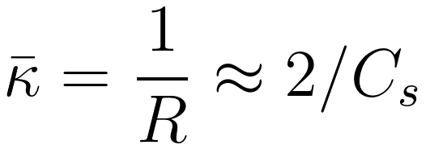
Introduction
Main flow features:
Turbulence ejection
Recirculation
Curved, Accelerated, Free Shear Layer
Typical Curvature
(Average along SL)
1
Cs
2
K
3
Above: Vortices in a slat cove visualised using ProLB simulation
4

Slide 9
Introduction
Main flow features:
Turbulence ejection
Recirculation
Curved accelerated Free
Shear Layer
Spanwise to streamwise vorticity transfer
1
4
2
3
Two novel hypotheses
a) Due to curvature
b) Due to acceleration
(Prof. M C Medeiros, Brazil)
5

Slide 10
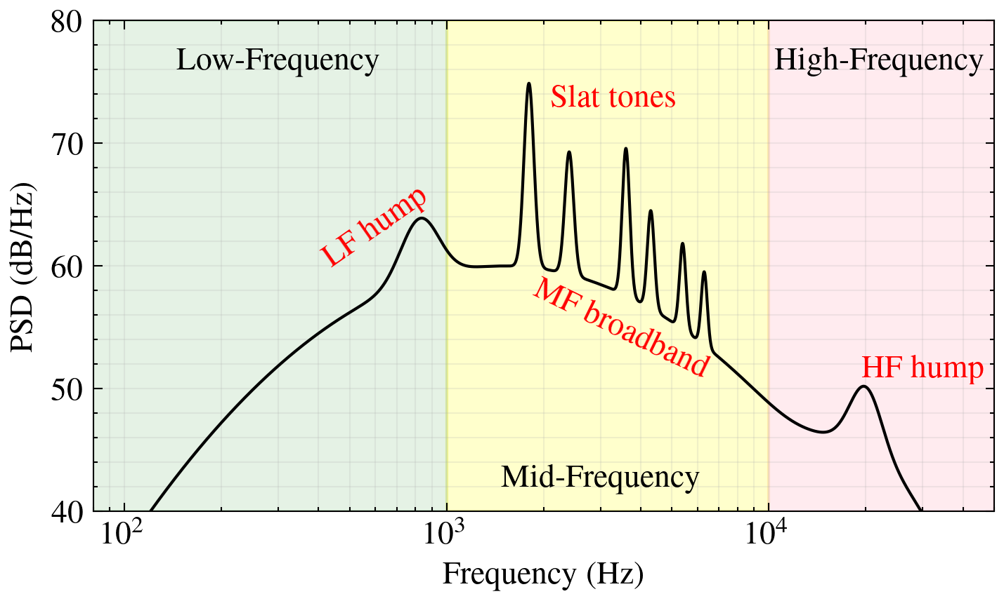
Introduction
Main flow features:
Turbulence ejection
Recirculation
Curved accelerated Free
Shear Layer
Spanwise to streamwise vorticity transfer
1
4
2
3
1
Noise Sources:
Broadband – Turbulence ejection
Rossiter Tones* – Aeroacoustic Resonance
* Only subscale models
6

Slide 11
Introduction
Main flow features:
Turbulence ejection
Recirculation
Curved accelerated Free
Shear Layer
Spanwise to streamwise vorticity transfer
Acoustic
Feedback
Vortex Convection
Resonance
1
7

Slide 12
Introduction
Main flow features:
Turbulence ejection
Recirculation
Curved accelerated Free
Shear Layer
Spanwise to streamwise vorticity transfer
Acoustic
Feedback
Vortex Convection
Resonance
1
7

Slide 13
Introduction
Main flow features:
Turbulence ejection
Recirculation
Curved accelerated Free
Shear Layer
Spanwise to streamwise vorticity transfer
Noise Sources:
Tonal – Rossiter modes
Broadband
1
4
2
3
Above: Vortices in a slat cove visualised using ProLB simulation
2

Slide 14
Theme 1
Aero-Acoustic Surrogate Modelling
ProLB (LBM)
Ffowcs Williams-Hawkings
Gaussian Process Regression
}
CAA
- ML

Slide 15

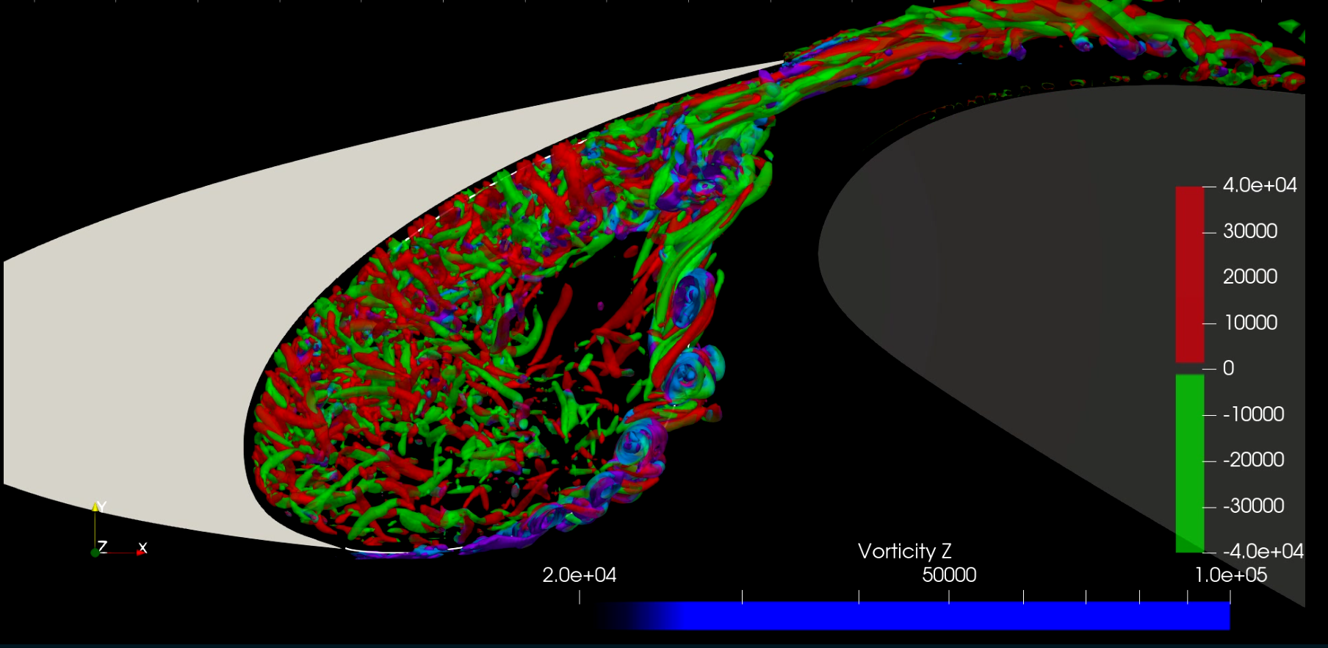

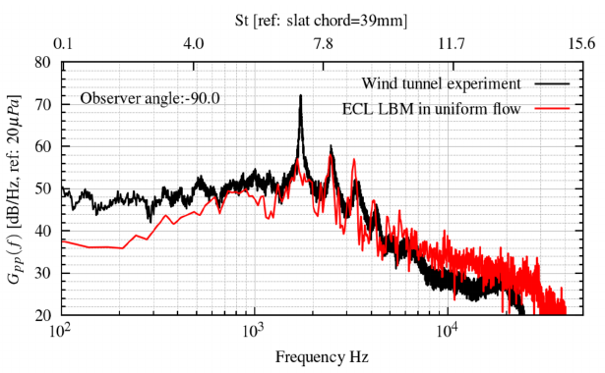

LBM - CAA Framework
ProLB enables
Unsteady 3D LBM-LES (SISM)
Low dissipation for CAA
Immersed Boundary Method
Each simulation
86M Voxels
960 CPUs x 51.54 Hrs
1
Data Recording
FWH
TurbAc’An
2
FWH approach for noise computation using TurbAc’An
Pressure side observer, 90deg, R = 1m
8

Slide 16
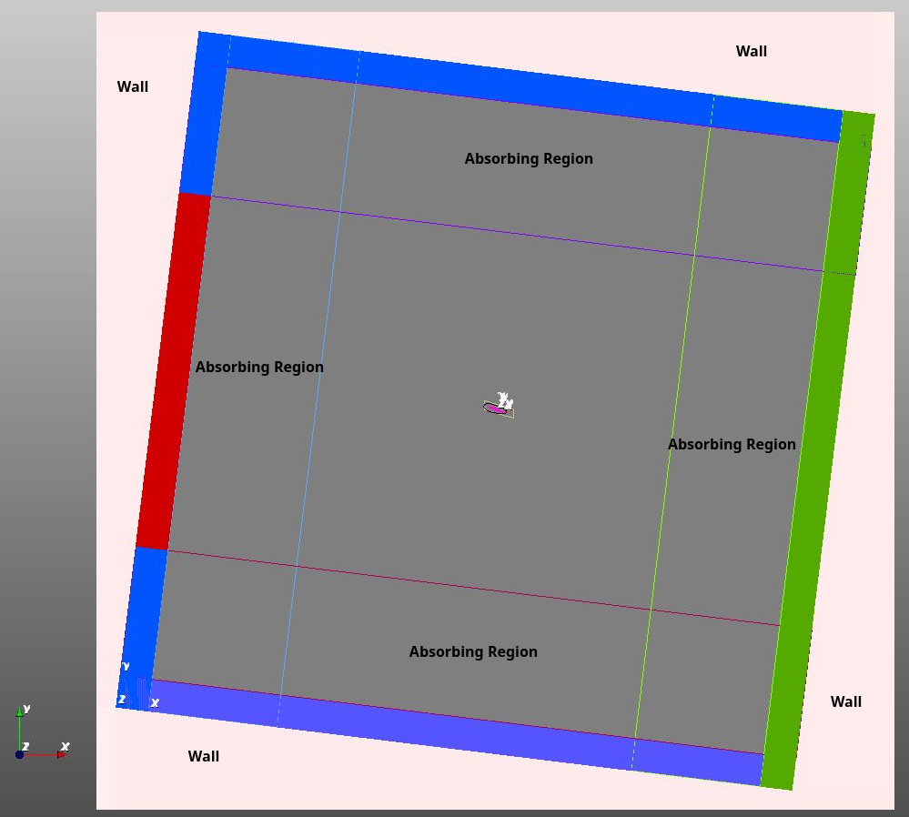
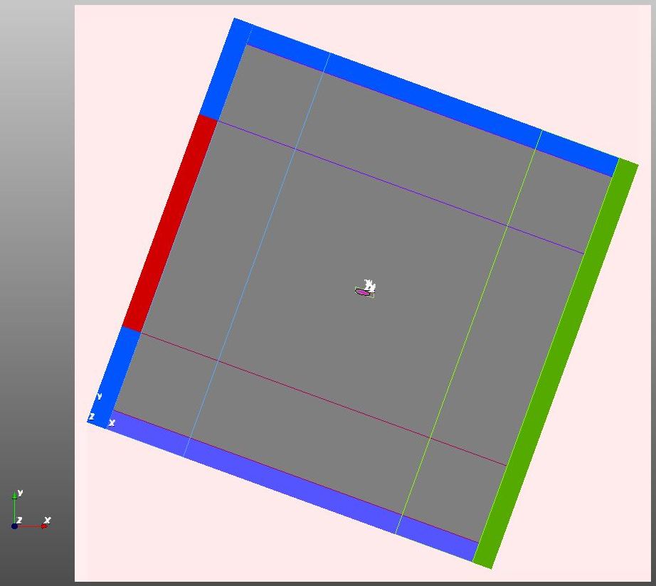
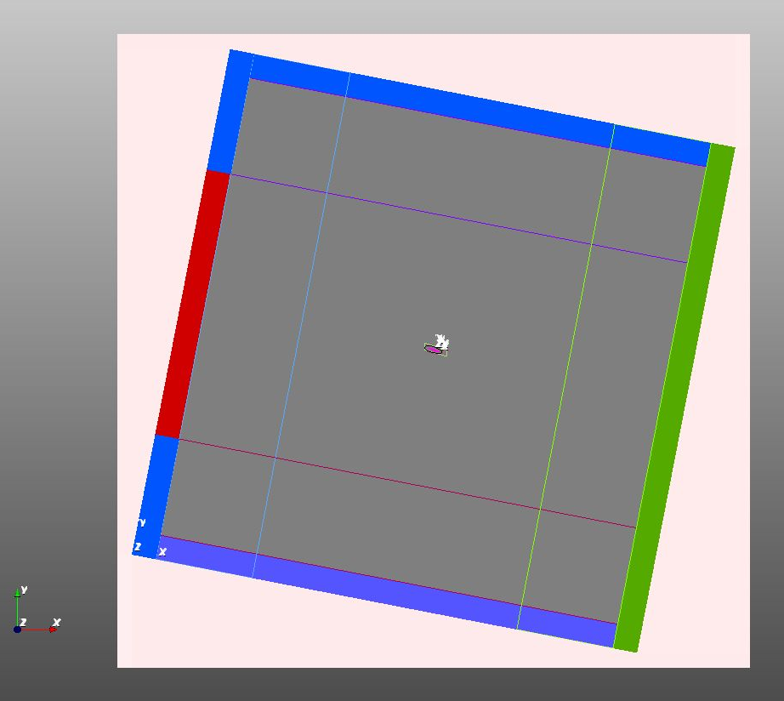
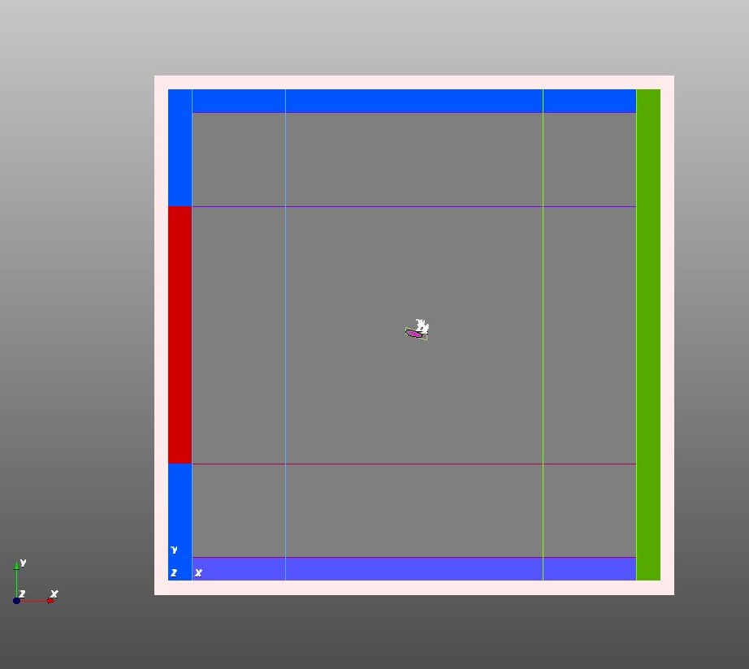
ProLB LBM – In Detail
Pressure = 1atm
No Mesh
No Mesh
30C x 30C domain
0.7C spanwise
BCs with sponge zones
Spanwise periodic BC
6 Refinement levels with coarsening factor of 2
Level - 1 @ 0.2 mm
Wall y+ = 35
Rotating BCs with static HLD
(BCs rotated to vary AOA)
compatibility between simulation/postprocessing CDS
Immersed boundary method enable hands free meshing
Sponge region
Inlet U=50m/s
HLD
Pressure = 1atm
Pressure = 1atm
No Mesh
No Mesh
Rotating domain with static HLD
9

Slide 17
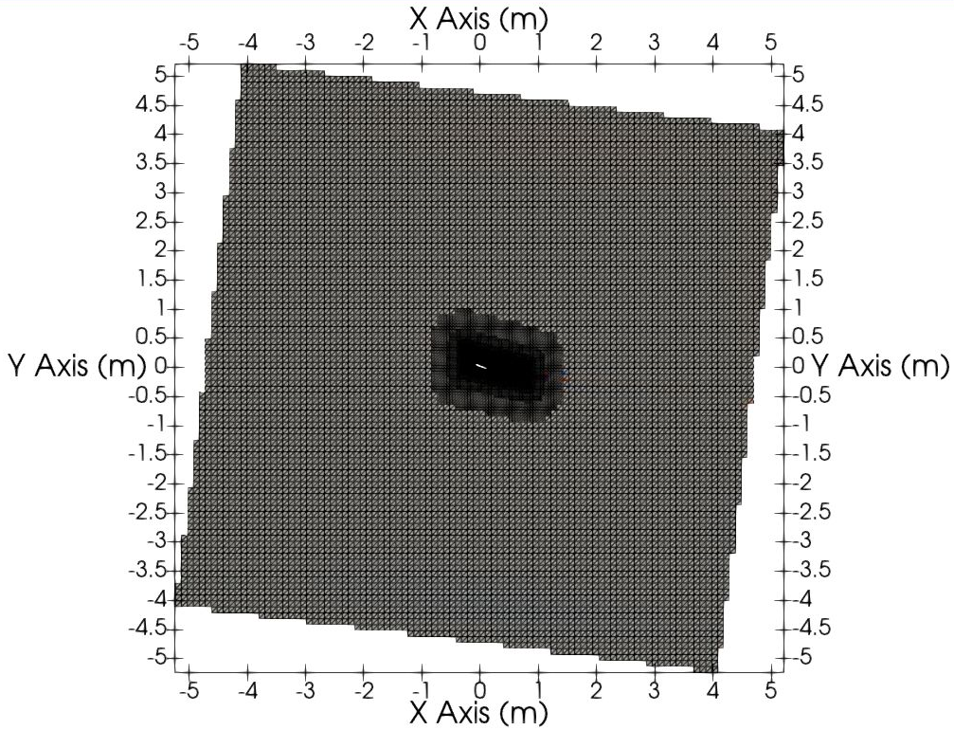
Pressure = 1atm
No Mesh
No Mesh
Inlet U=50m/s
HLD
Pressure = 1atm
No Mesh
No Mesh
Pressure = 1atm
10

Slide 18
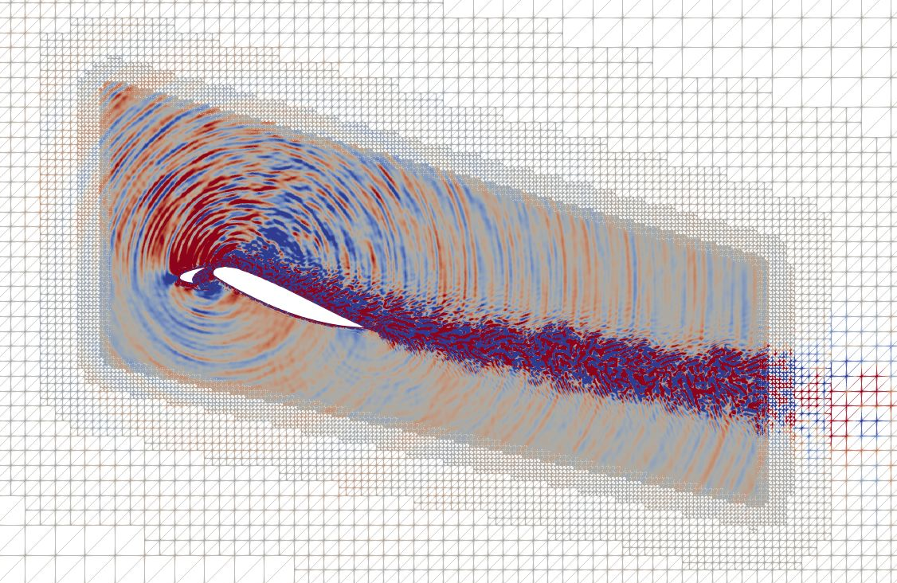
Pressure = 1atm
No Mesh
No Mesh
Inlet U=50m/s
HLD
Pressure = 1atm
No Mesh
No Mesh
Pressure = 1atm
10

Slide 19
Pressure = 1atm
No Mesh
No Mesh
Acoustic propagation region
Inlet U=50m/s
HLD
Pressure = 1atm
No Mesh
No Mesh
Pressure = 1atm
Voxel coarsening factor: 2
Ref Level 4 @ Δx = 0.0016m
10

Slide 20
Pressure = 1atm
No Mesh
No Mesh
Ref Lvl 8
Acoustic propagation region
Inlet U=50m/s
HLD
Pressure = 1atm
Ref Lvl 8
Ref Lvl 7
No Mesh
Ref Lvl 4
No Mesh
Pressure = 1atm
Voxel coarsening factor: 2
Ref Level 4 @ Δx = 0.0016m ??
10

Slide 21
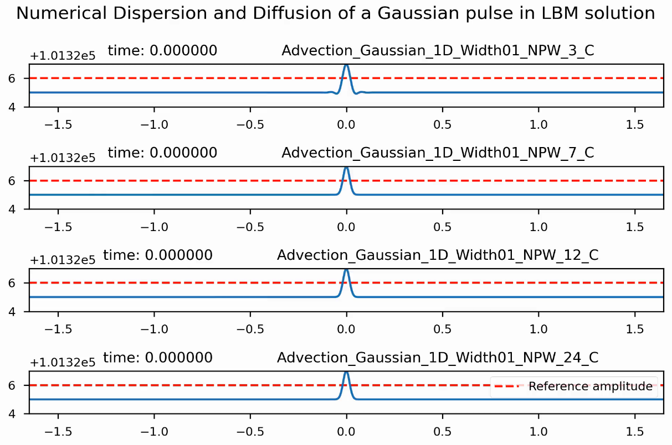
Mesh criteria for acoustics
A classical Gaussian pulse test case for empirical testing of dissipation
11

Slide 22
Mesh criteria for acoustics
A classical Gaussian pulse test case for empirical testing of dissipation
Coarse Mesh
3PPW @ 10kHz
Fine Mesh
24PPW @ 10 kHz
11

Slide 23



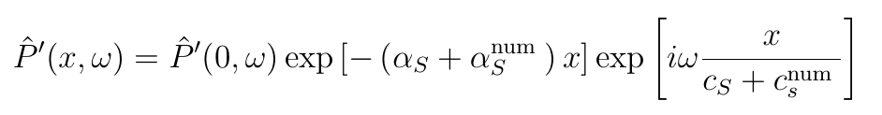
Mesh criteria for acoustics
Linearised adiabatic NS system
Plane Wave
NL Dispersion relation
Fourier transforms at varying locations allow dispersion and dissipation testing
11

Slide 24
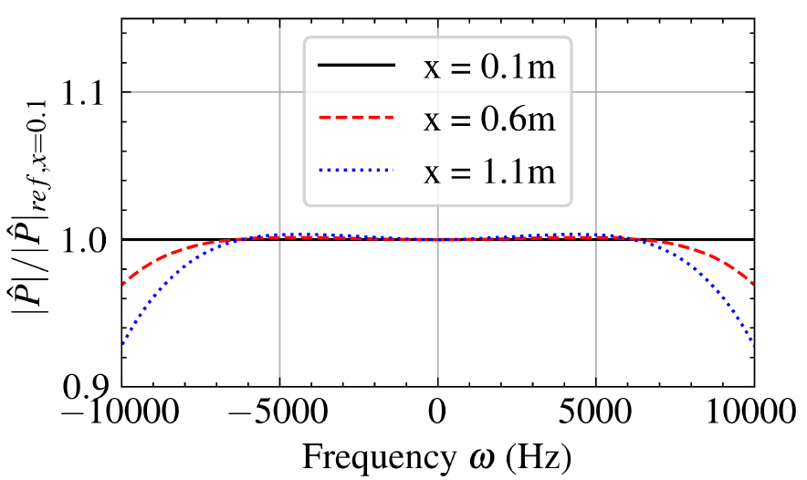
Mesh criteria for acoustics
Linearised adiabatic NS system
Plane Wave
NL Dispersion relation
Fourier transforms at varying locations allow dispersion and dissipation testing
11

Slide 25
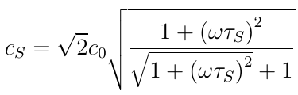
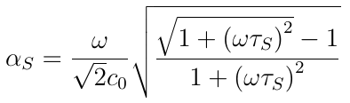
Mesh criteria for acoustics
Linearised adiabatic NS system
Plane Wave
NL Dispersion relation
Fourier transforms at varying locations allow dispersion and dissipation testing
From Kinetic Theory
11

Slide 26
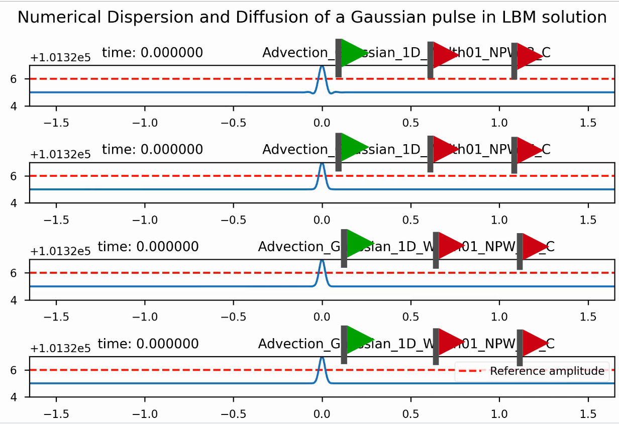
Mesh criteria for acoustics
Linearised adiabatic NS system
Wave form
NL Dispersion relation
Fourier transforms at varying locations allow dispersion and dissipation testing
11

Slide 27
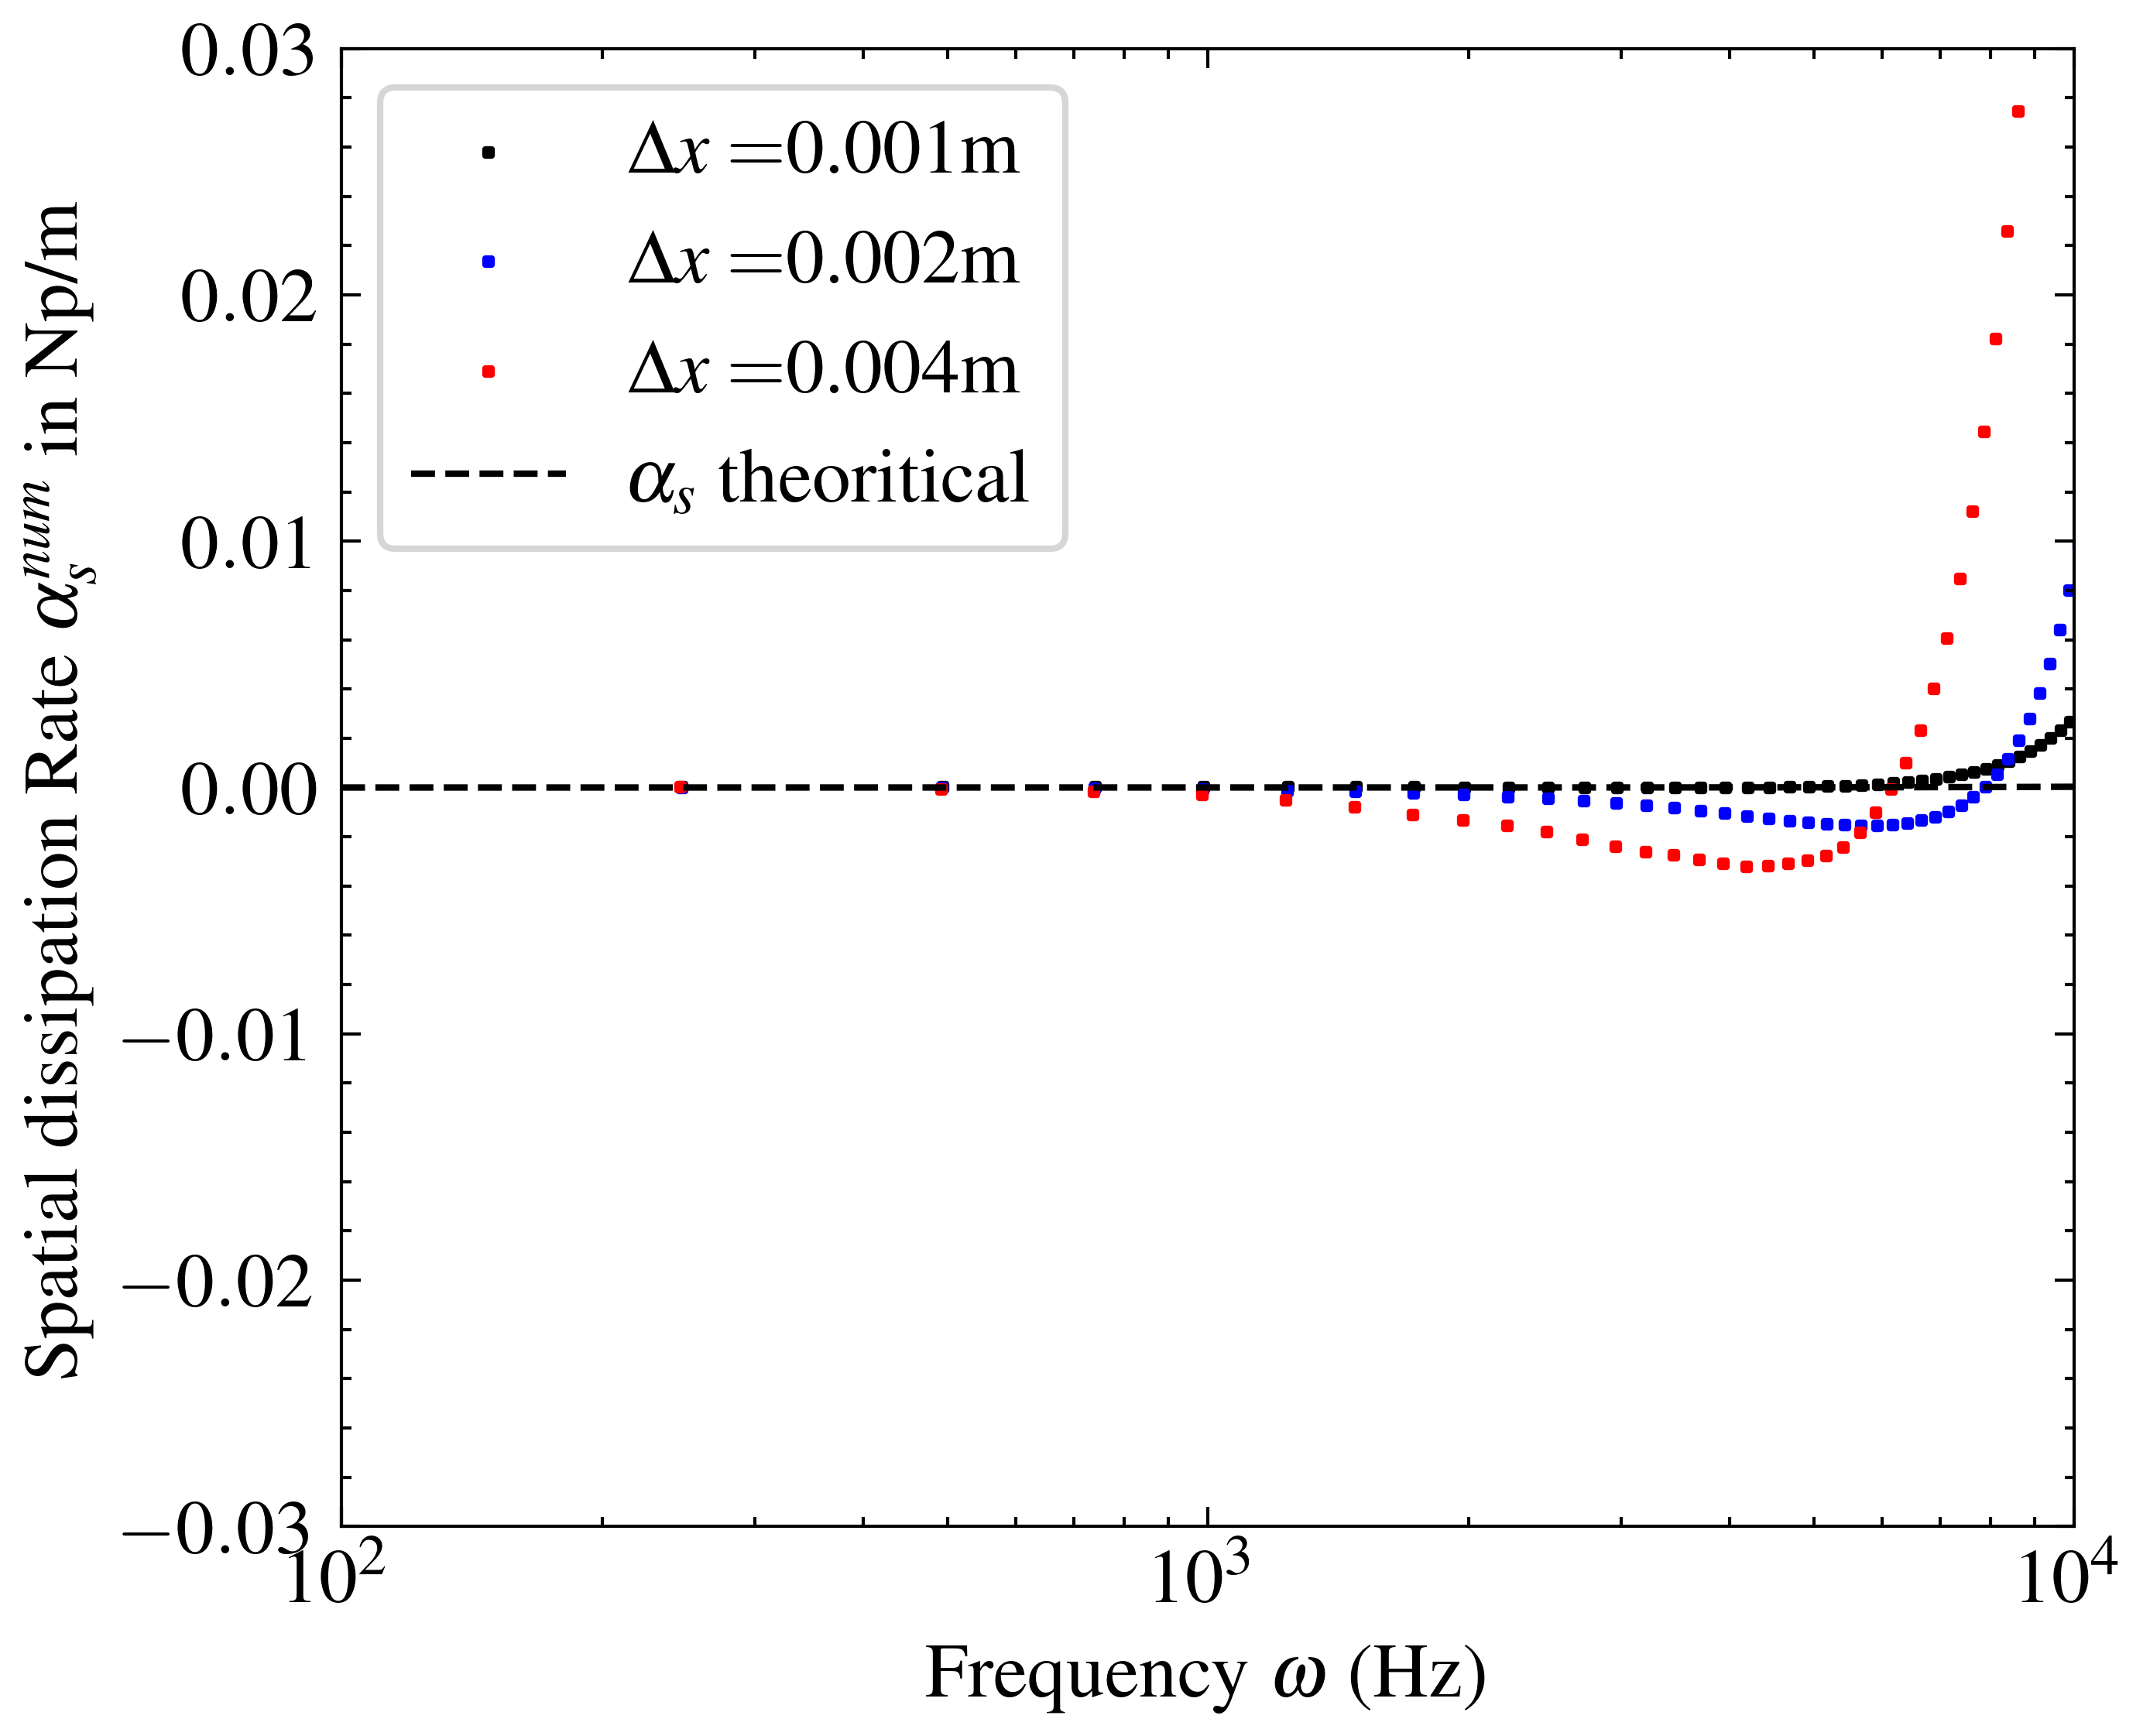
Focus : LBM-Details
12

Slide 28
Mesh criteria for acoustics
- 34 PPW @ 10kHz
- 17 PPW
- 8 PPW
Dissipation rate for various mesh sizes
12

Slide 29
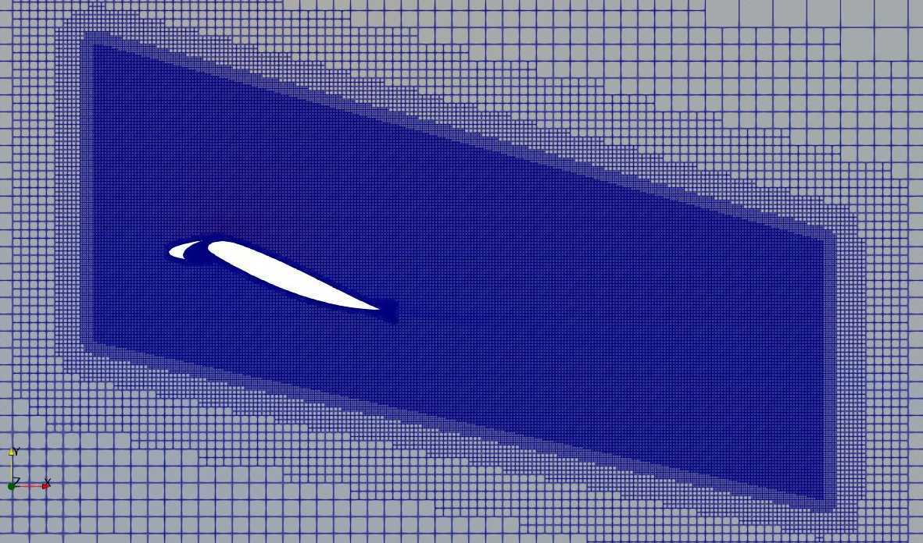
Mesh criteria for acoustics
17PPW at 10kHz incur <0.1dB/m of dissipation
- 34 PPW @ 10kHz
- 17 PPW
- 8 PPW
Dissipation rate for various mesh sizes
12
FWH propagation region

Slide 30
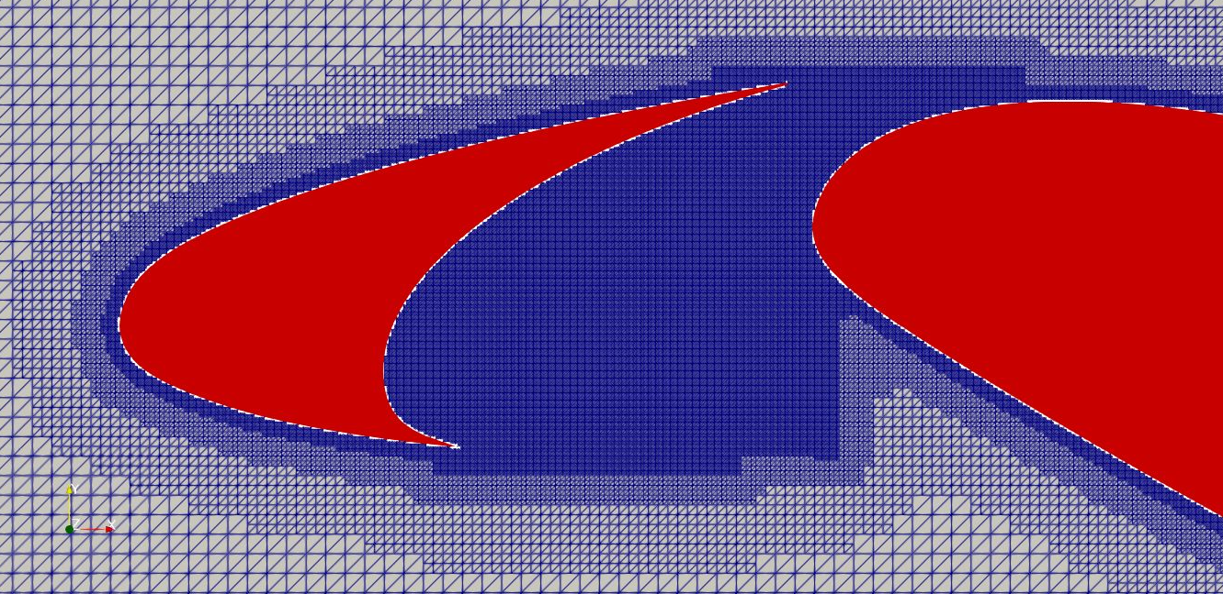
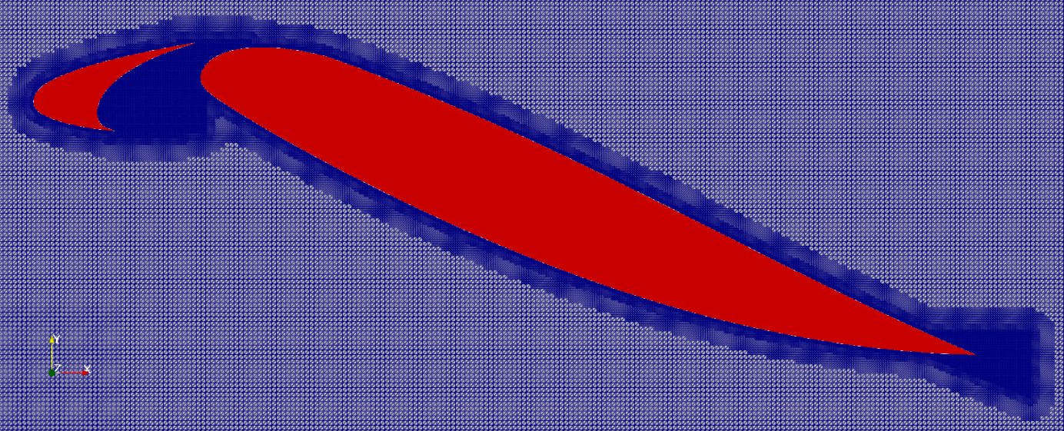
Final Mesh
17PPW at 10kHz incur <0.1dB/m of dissipation
Wall y+ of 35 at 0.2mm at Ref. Lvl. 1
Cove region
- 34 PPW @ 10kHz
- 17 PPW
- 8 PPW
Around the HLD
Linear acoustic wave dissipation rate in ProLB
– Murali et al. 2022
FWH propagation region
12

Slide 31
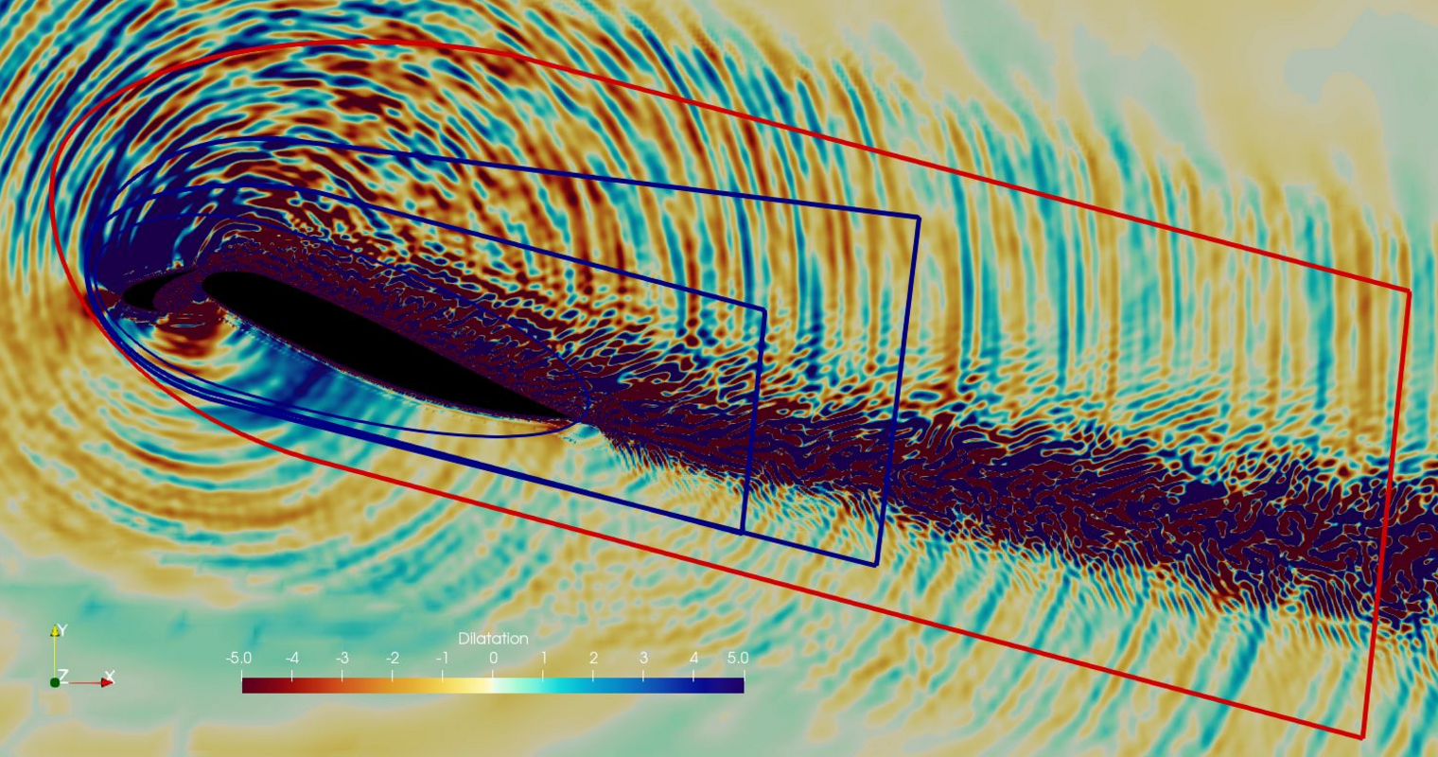
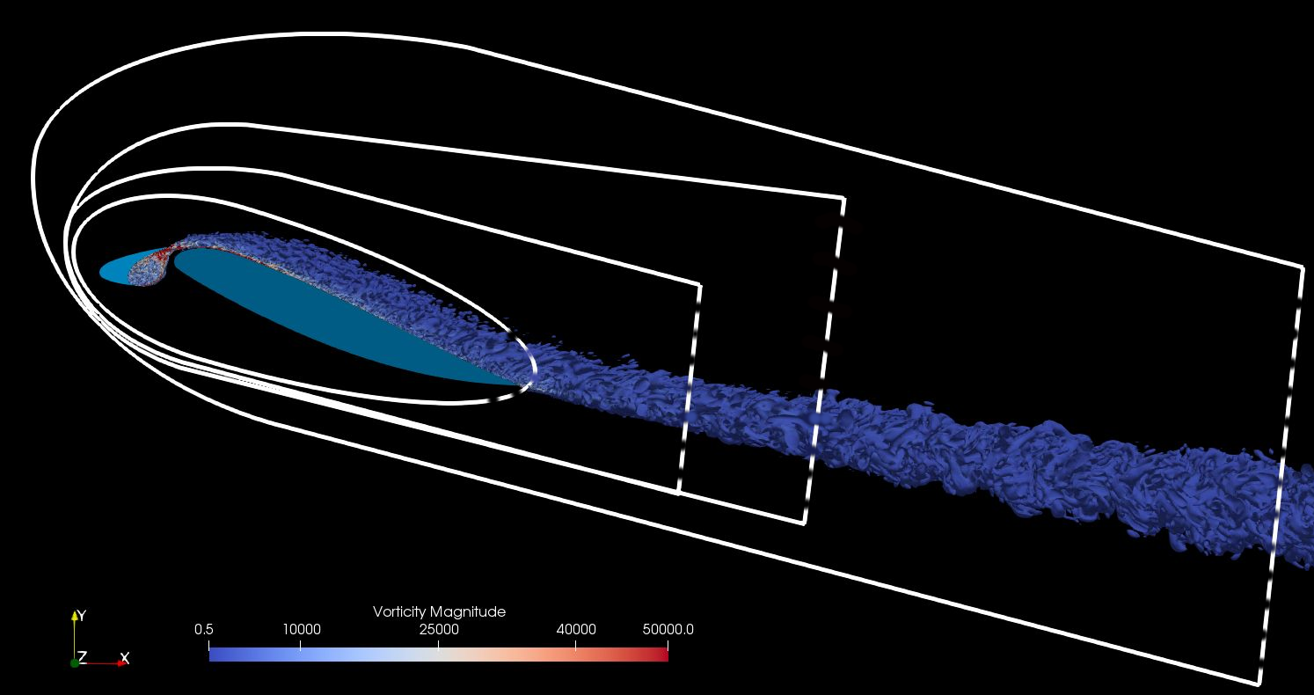
FWH Surface placement
Noise source region
Dilatation field and FWH surfaces
Q-crit vortices and FWH surfaces
Permeable FWH surface needs to be placed outside region of turbulence
4 surface tested and farthest surface was chosen for parametric simulation
Requires good resolution (17PPW) until the FWH surface
Computed farfield spectrum against experiment ~ Murali et al. 2022
13

Slide 32


FWH Surface placement
Noise source region
Dilatation field and FWH surfaces
Q-crit vortices and FWH surfaces
Permeable FWH surface needs to be placed outside region of turbulence
4 surface tested and farthest surface was chosen for parametric simulation
Requires good resolution (17PPW) until the FWH surface
Computed farfield spectrum against experiment ~ Murali et al. 2022
13

Slide 33
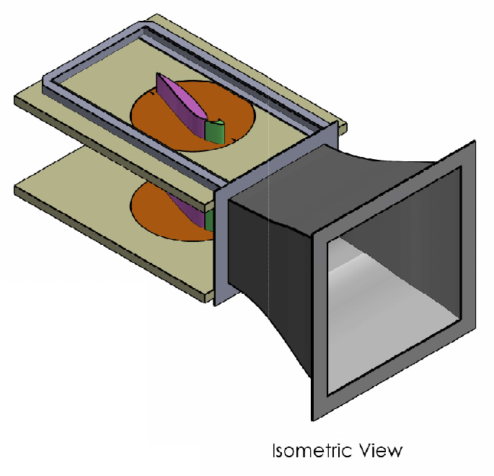
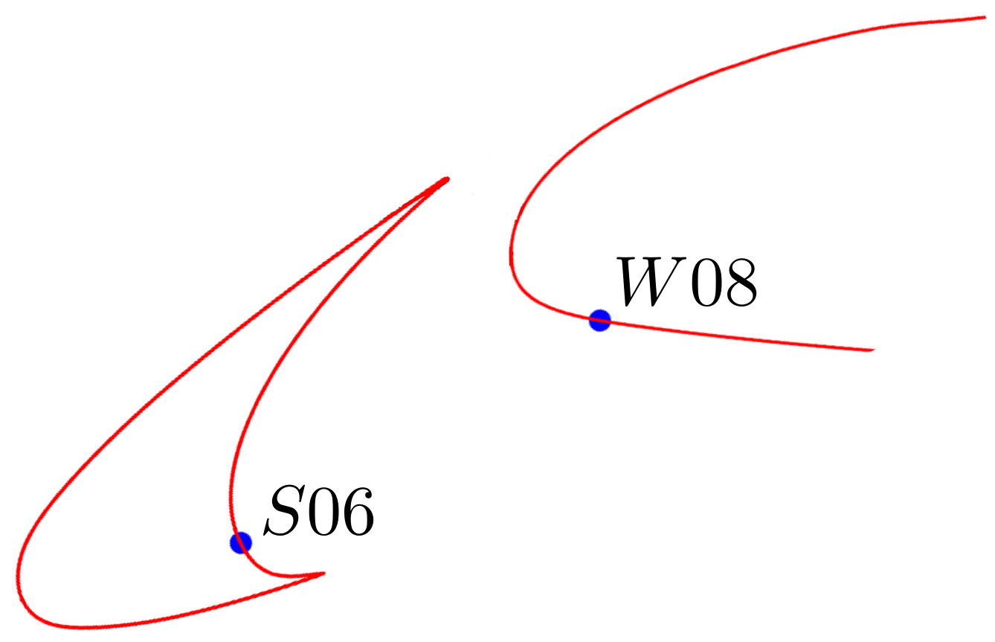
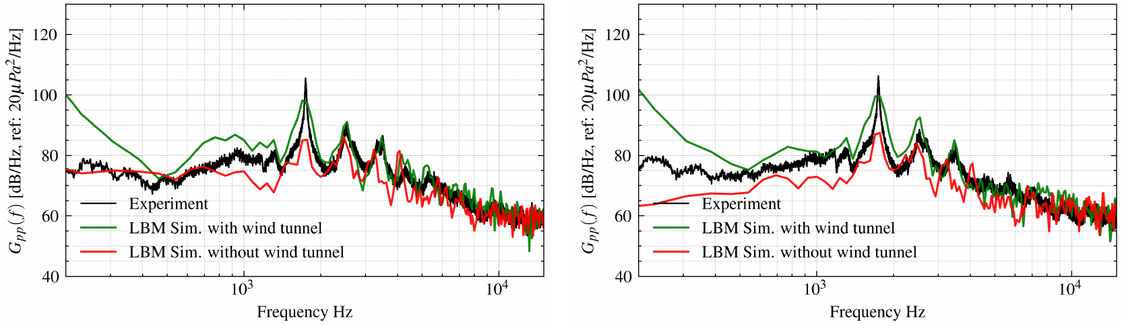
Presence of Wind Tunnel
Wind tunnel has lateral sidewalls
Spectra differences are due to flow physics and NOT numerical issue!
14

Slide 34
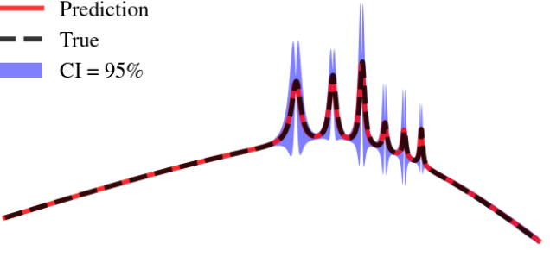
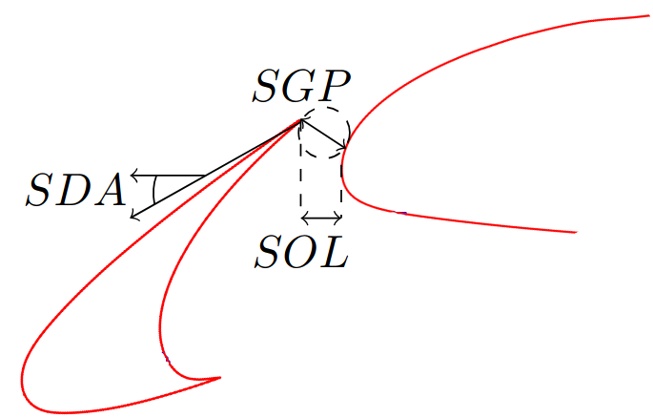

Bayesian Active Learning
for
Noise Spectra
Gaussian Process

Slide 35
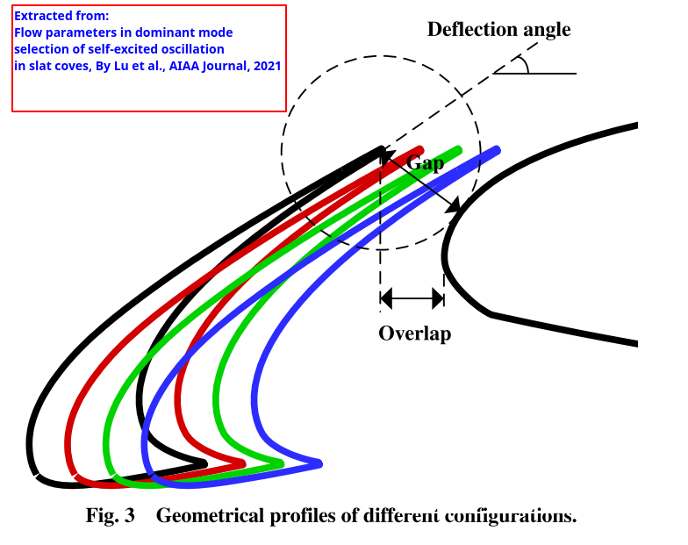
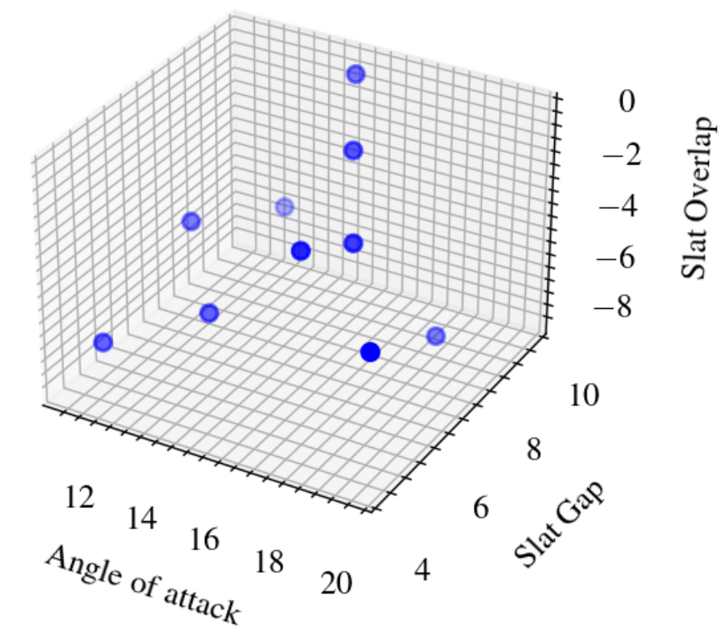
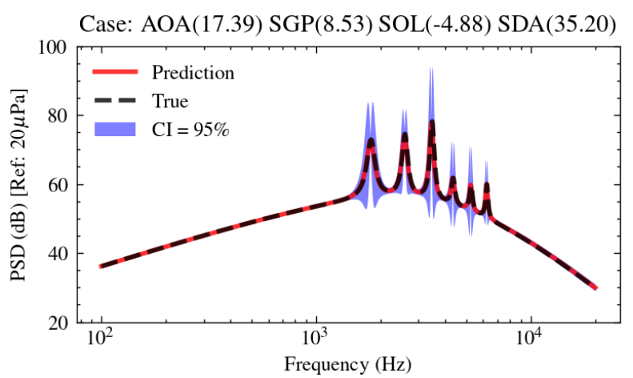


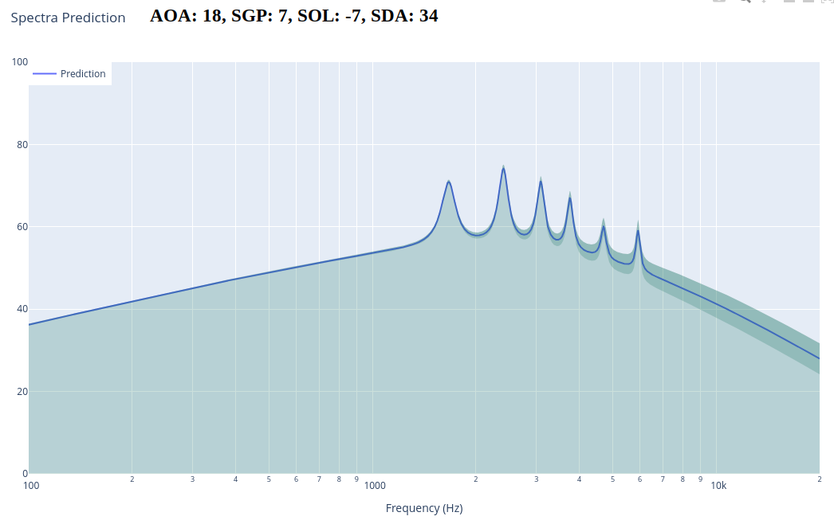
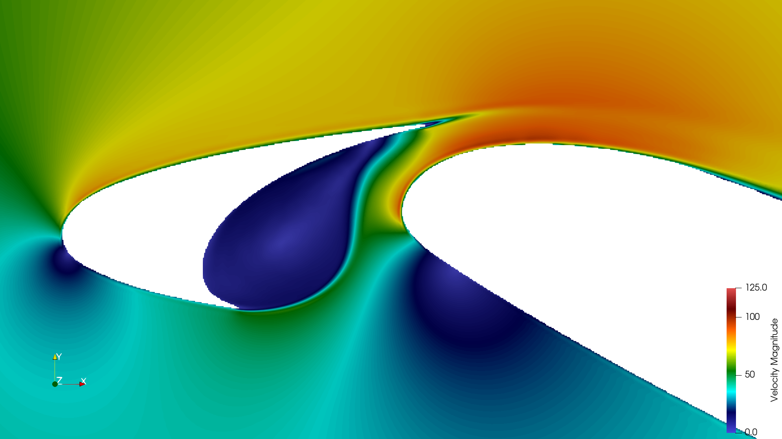
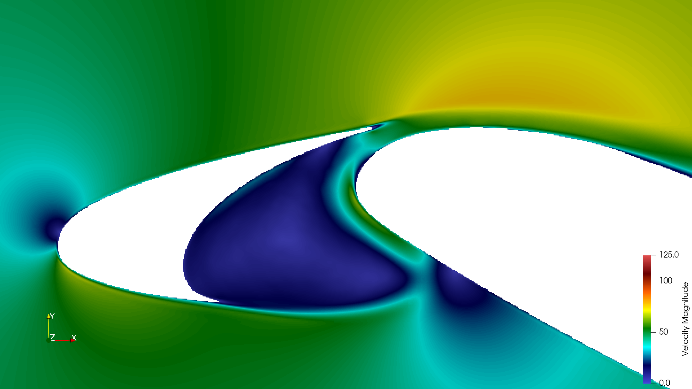
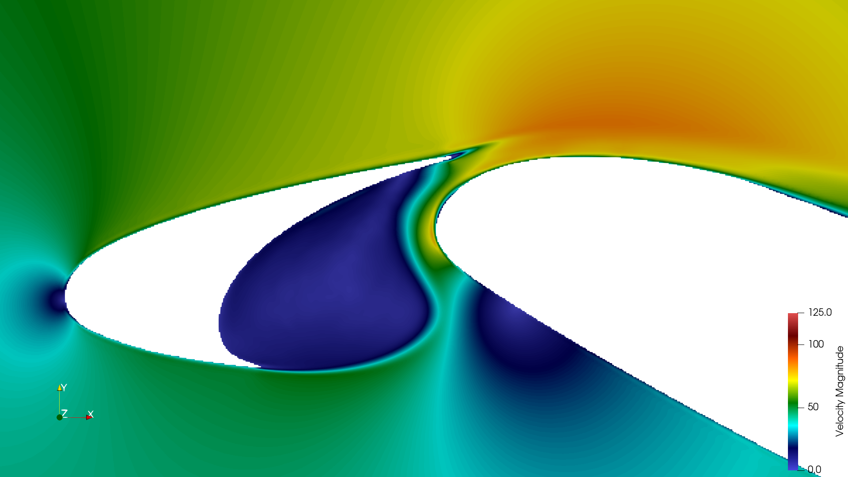
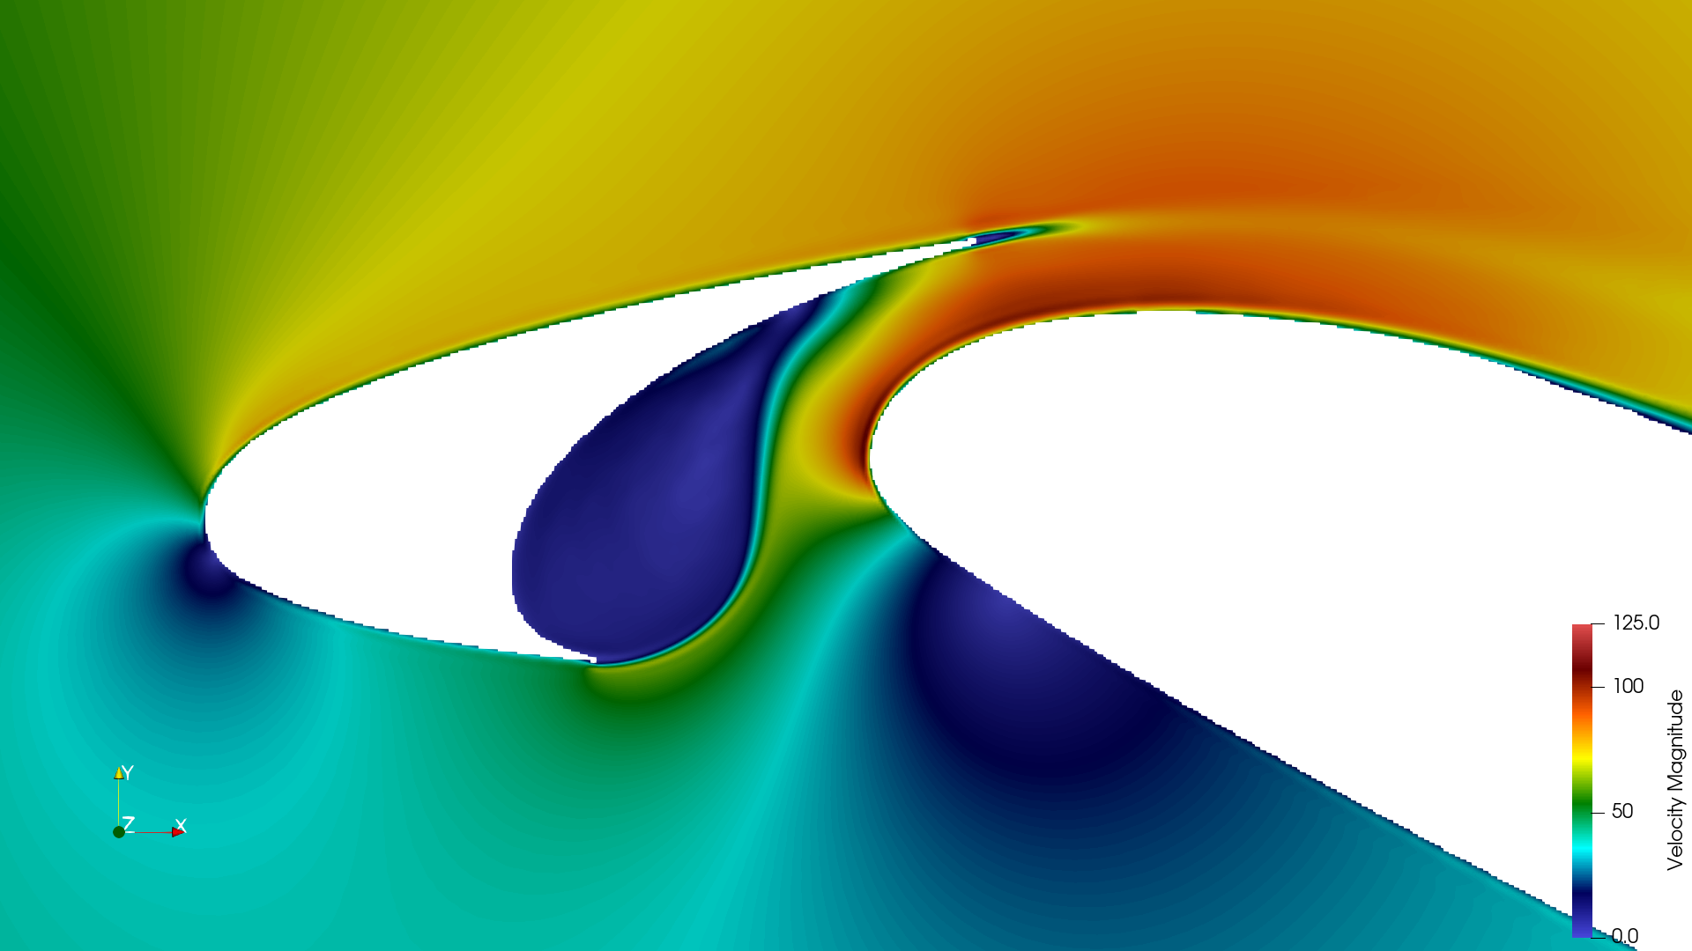
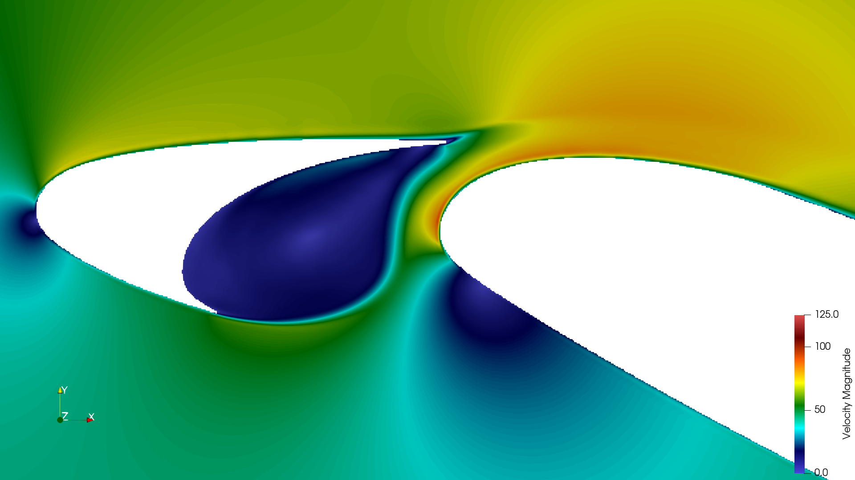
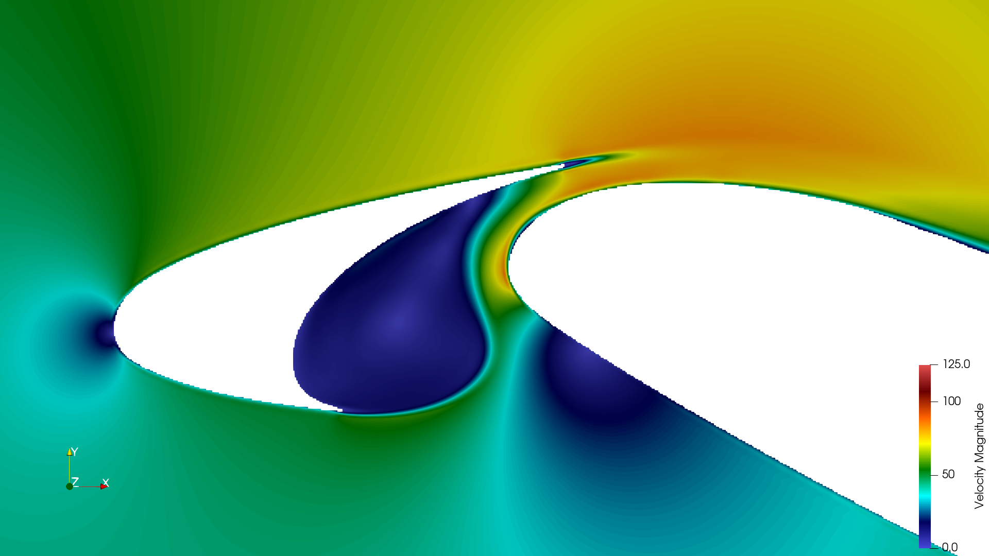
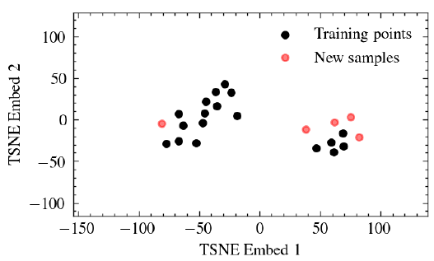
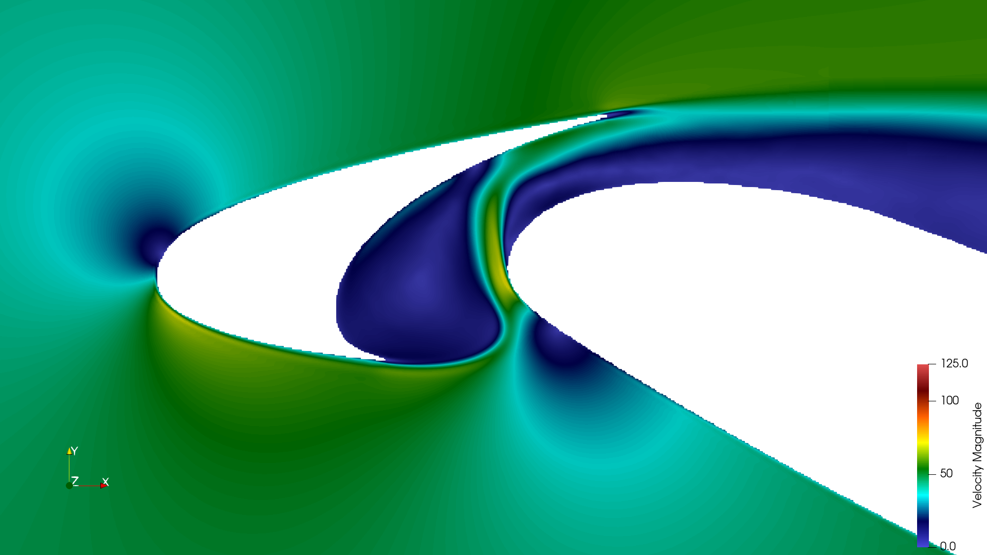
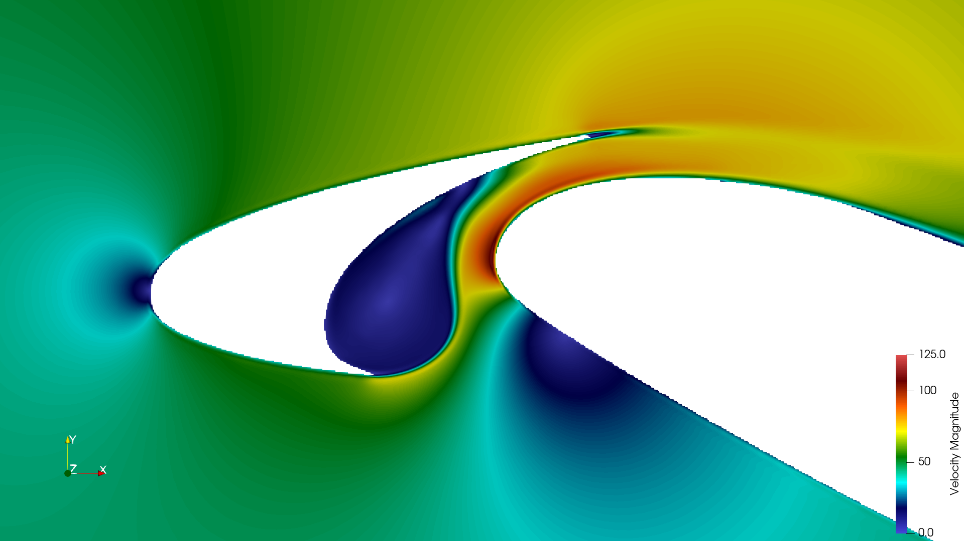
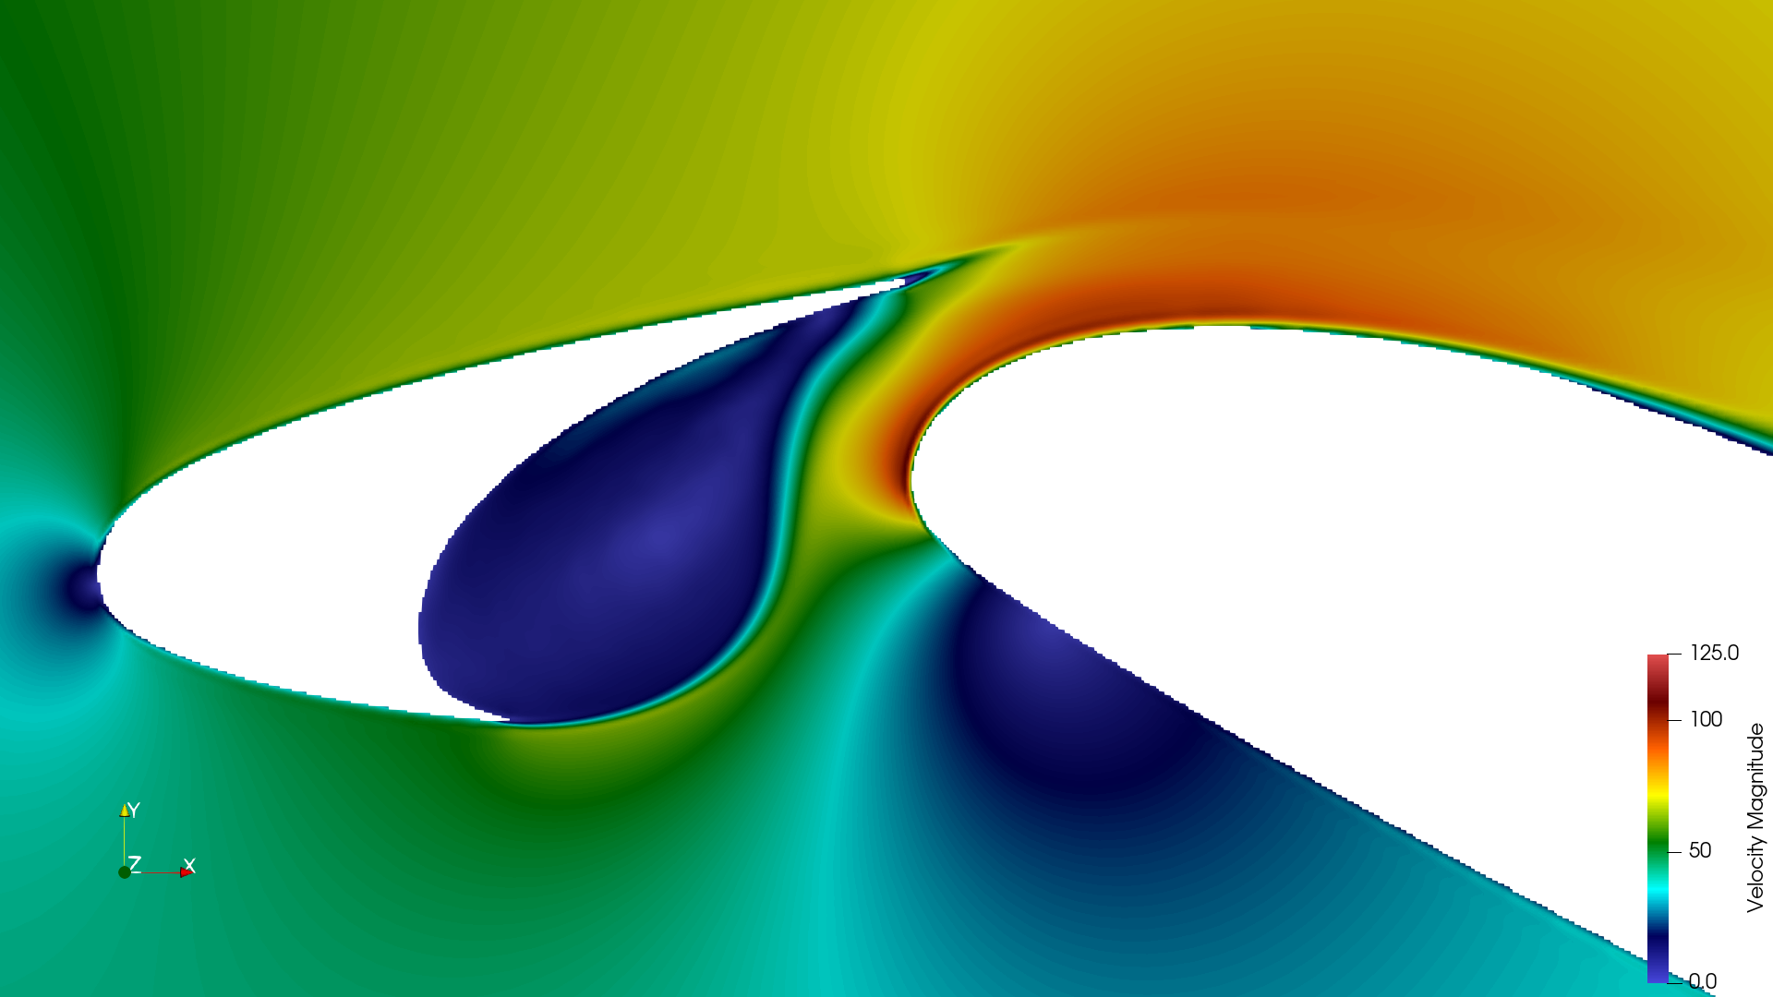
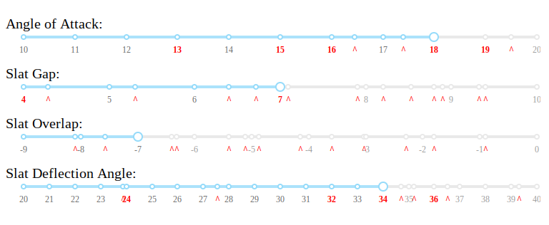
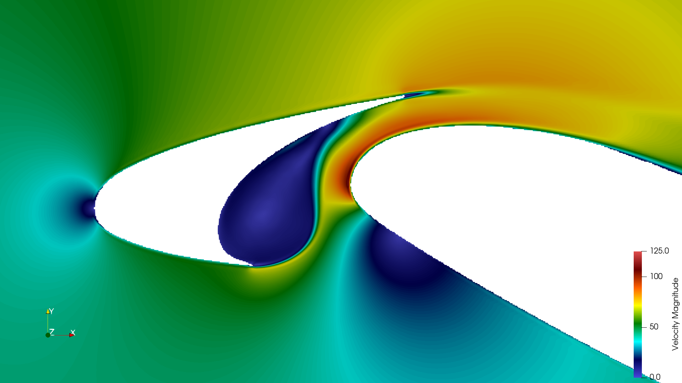











Bayesian Active Learning
Initial sample
Surrogate model for noise spectra and uncertainities
Geometry parameters 4D
TurbAc’An
Stochastic sampling
(UCB)
Stochastic Sampling around noisy
configuration
Domain monitoring dashboard
Dataset – Flow & Noise Spectra
15

Slide 36
Bayesian Active Learning
Initial sample
Surrogate model for noise spectra and uncertainities
Geometry parameters 4D
TurbAc’An
Active Learning Loop
Stochastic sampling
(UCB)
Stochastic Sampling around noisy
configuration
Domain monitoring dashboard
Dataset – Flow & Noise Spectra
16

Slide 37



Physics based Spectral Shape
Feature Extraction
Extract BB shape using Guo’s shape function
Extract tonal peaks as Lorentians
Total parameters per spectra: 17 variables
Procedure
Fit Guo’s shape function by Least Squares
(limit domain to 1000 to 7000Hz)
Locate peaks by deviation from Shape function
Assume : peaks frequencies are unrelated
(peak interaction and modulation not accounted in Souza’s model)
Fit peak amplitudes using least squares
17

Slide 38




Gaussian Process Regression
(GPR)
Linear regression
Gaussian Noise
Non - Linear basis
S.N. | Input features (X) |  |  |  | Target x 17 (y)
1 | AOA_11 | SDA_21 | SGP_31 | SOL_41 | y1
2 | AOA_12 | SDA_22 | SGP_32 | SOL_42 | y2
3 | AOA_13 | SDA_23 | SGP_33 | SOL_43 | y3
4 | AOA_14 | SDA_24 | SGP_34 | SOL_44 | y4
Bayes’ Theorem allows inversion of
conditional probabilities
Bayes’ theorem applied on the dataset to obtain model weights
GPR is a non-linear regression with added stochastic noise
Independent Gaussian Processes are used for each of 17 target variables
18

Slide 39
Gaussian Process Regression
(GPR)
Linear regression
Gaussian Noise
Non - Linear basis
S.N. | Input features (X) |  |  |  | Target x 17 (y)
1 | AOA_11 | SDA_21 | SGP_31 | SOL_41 | y1
2 | AOA_12 | SDA_22 | SGP_32 | SOL_42 | y2
3 | AOA_13 | SDA_23 | SGP_33 | SOL_43 | y3
4 | AOA_14 | SDA_24 | SGP_34 | SOL_44 | y4
Bayes’ Theorem allows inversion of
conditional probabilities
Likelihood
Prior
Posterior
Bayes’ theorem applied on the dataset to obtain model weights
GPR is a non-linear regression with added stochastic noise
Independent Gaussian Processes are used for each of 17 target variables
19

Slide 40


Gaussian Process Regression
(GPR)
S.N. | Input features (X) |  |  |  | Target (y)
1 | AOA_11 | SDA_21 | SGP_31 | SOL_41 | y1
2 | AOA_12 | SDA_22 | SGP_32 | SOL_42 | y2
3 | AOA_13 | SDA_23 | SGP_33 | SOL_43 | y3
4 | AOA_14 | SDA_24 | SGP_34 | SOL_44 | y4
5* | AOA_15* | SDA_25* | SGP_35* | SOL_35* | y5*
Analytical formula for the predictive distribution
19

Slide 41


Gaussian Process Regression
(GPR)
S.N. | Input features (X) |  |  |  | Target (y)
1 | AOA_11 | SDA_21 | SGP_31 | SOL_41 | y1
2 | AOA_12 | SDA_22 | SGP_32 | SOL_42 | y2
3 | AOA_13 | SDA_23 | SGP_33 | SOL_43 | y3
4 | AOA_14 | SDA_24 | SGP_34 | SOL_44 | y4
5* | AOA_15* | SDA_25* | SGP_35* | SOL_35* | y5*
Analytical formula of predictive distribution reduces to only
a function of the Kernel K – The Kernel Trick
20

Slide 42




Acquisition
and Active Learning
Acquisition Function:
Bayesian Upper Confidence Bound (UCB)
Sampling based on UCB
Opt: 0.15
Thresholded utility function used for stochastic sampling
f(x)
Sampling density
Pivot
Sampling
21

Slide 43

Acquisition
and Active Learning
Acquisition Function:
Bayesian Upper Confidence Bound (UCB)
Sampling based on UCB
Opt: 0.15
Thresholded utility function used for stochastic sampling
Sampling density
Pivot
Sampling
21

Slide 44



Regression Results
Final regression
Input: 4D positional coordinates
Target: 17D spectrum
Uncertainity
Higher tone
amplitudes
Figure: Maximum coefficient of variation
Higher uncertainities exists for higher tone amplitudes
Good fit for 17 variables in dataset
22

Slide 45




The Dataset
Noisy Case 22
Shear layer variety
Slat position varied to investigate the spectra
Key observations
Shear layer shape and exit velocity are the major features
Noise most sensitive to slat gap
Case 22 slat position
– is nearly the most noisy
– spectra closest to Standard position
23

Slide 46
Theme 2
Slat Cove Dynamics

Slide 47




Steady Spanwise Velocity Cells
Case 11
Case 22, most noisy
Case 5
Strong three dimensionality noticed in the spanwise mean velocity field
Not directly linked to the generation of tones
But modulate them
Case 29
24

Slide 48
Steady Spanwise Velocity Cells
Case 11
Case 5
Case 22, most noisy
Strong three dimensionality noticed in the spanwise mean velocity field
Not directly linked to the generation of tones
But modulate them
Case 29
24

Slide 49
Strong three-dimensionality
Spanwise velocity disribution inside the slat cove showing well arranged cell formation
25

Slide 50



Strong three dimensionality
A1
B1
Leads to generation of converging and diverging planes
Question: Is it an artifact of spanwise periodic condition ???
A1
B1
26

Slide 51
Strong three dimensionality
U_{z} Diverging Planes
A1
B1
Leads to generation of converging and diverging planes
Question: Is it an artifact of spanwise periodic condition ???
A1
B1
26

Slide 52




Simulation including the Wind Tunnel
(With Florian Guiho, Airbus )
Wind tunnel simulation geometry with no requirement for spanwise periodic condition
They are NOT artifacts of spanwise BC
Walls affect 80% of the spanwise domain
Cell formation
27

Slide 53




Velocity across Shear Layer
Spanwise axis, Z
Probe 24
Probe 0
Shear Layer line
28

Slide 54


Hot wire probes
Spanwise axis, Z
Probe 14 – Just outside the shear layer
29

Slide 55







Spanwise variation of spectra
Probe 24
Inside SL
Probe 20
Slightly inside SL
Probe 17
On the SL
Probe 14
Slightly outside SL
S/N: 8
30

Slide 56
Spanwise variation of spectra
Probe 24
Inside SL
Probe 20
Slightly inside SL
Probe 17
On the SL
Probe 14
Slightly outside SL
S/N: 8
31

Slide 57

Visualisation
Burst event
Shear layer bursting at 0.214s, 0.219s, ...
32

Slide 58
Visualisation
Shear layer bursting at 0.214s, 0.219s, ...
32

Slide 59
Visualisation
Shear layer bursting at 0.214s, 0.219s, ...
Intermittent behaviour at TE*
Random convection path
for burst vortices
* Reference: Intermittent and stochastic characteristics of slat tones, Hasan KJ 2021
32

Slide 60


Visualisation
Shear layer bursting at 0.214s, 0.219s, ...
Spanwise coherence is broken periodically by “Bursting” of the shear layer
Spanwise coherence periodically broken leads amplitude modulation of Rossiter modes
33

Slide 61
Visualisation
Shear layer bursting at 0.214s, 0.219s, ...
33

Slide 62


Spanwise modulation in Cavity flows are still being explored
Spanwise velocity modulation for flow over a backward facing step
– Barkley 2002
Spanwise velocity modes in a rectangular cavity
– Bres et. al. 2008
Spanwise modulations are suspected to be an effect of the curvature effect although not definitively
Bres et al. showed that spanwise cells have a pulsation at frequency one order of magnitude lower than Rossiter modes
They also modulate Rossiter tones
33

Slide 63



Cove Recirculation Frequency
The recirculation time for first streamline loop corresponds tp approx 200 Hz
Consistent across all cases
3D streamline
34

Slide 64




Cove Recirculation Frequency
Case 22 – Most noisy case
35

Slide 65




Cove Recirculation Frequency
Recirculation frequency well defined even when there are no cells
35

Slide 66
Focus : Unsteady field and the Spanrollers
- Vorticity Conversion

Slide 67



Ejected vorticity is majorly streamwise
36

Slide 68
Ejected turbulence is majorly streamwise counter rotating
36

Slide 69




Streamline Curvature
Shear layer distortion leads to quiet configurations and even suppression of tones
~ Bradshaw, 1969
37

Slide 70



Tonal noise level based on Ri_{c}
Curvature Richardson number history can quantitatively suggest the presence of tones
Qualitatively, early curvature inflection leads to destruction of spanwise eddies, hence reduction of tonal noise strength
38

Slide 71
Conclusions
Thesis Contributions
A Bayesian Aeroacoustic Surrogate model coupled to ProLB for complex flows is constructed.
A spanwise mode formation previously undocumented is shown to exist.
A previously undiscovered spanwise localised LF oscillation at frequency of recirculation is demonstrated. Thus a mechanism via which spanwise modes affect the acoustics is demonstrated.
The spanwise to streamwise vorticity conversion is shown to affect the strength of tones – also theorised to be an effect of the shear layer curvature, and also possibly rectilinear acceleration.
39

Slide 72
Future directions
Expand the surrogate model and its database for industrial use confidence and as general purpose tool.
Improve the sampling efficiency by exploring other acquisition functions.
Explore a body fitted Green’s function using ML approaches (ANN) for complex geometries.
Establish the modulation at recirculation frequency experimentally using long time series recording of hot-wire probe data and across the span.
Establish whether linear acceleration or curvature is the major player in vorticity conversion.
Conduct Linear/Non-linear Stability Analysis to identify the instability modes due to curvature and acceleration
Quantitavely asses the variation of directional vorticity with respect to shear layer shapes/curvatures.
40

Slide 73
Thank you for Listening!

Slide 74

Absorbing Layer settings
Pressure = 1atm
No Mesh
Spanwise periodic
30C x 30C domain
BCs with non-reflecting conditions
HLD mesh static
(domain rotated to vary AOA) – compatibility between simulation/postprocessing
Immersed boundary method enable hands free meshing
No Mesh
Absorbing region
Pressure = 1atm
Inlet U=50m/s
Pressure = 1atm
No Mesh
No Mesh
A1

Slide 75


Absorbing Layer
LBM formulation
Analysis of the absorbing layers for the weakly-compressible lattice Boltzmann methods
~ Xu and Sagaut, 2013
A2

Slide 76

Absorbing Layer
LBM formulation
ProLB: A Lattice Boltzmann Solver of Large-Eddy Simulation for Atmospheric Boundary Layer Flows
~ Feng et al., 2021
A3

Slide 77

Focus : LBM-Details
Mesh criteria for acoustics
Classical test used to obtain mesh critera for acoustics (Bres et al. 2018)
Linearised adiabatic NS system
Wave form
NL Dispersion relation
Assuming complex wavenumber and real frequency
Fourier transforms at varying locations allow dispersion and dissipation testing
A4

Slide 78

ProLB Result from Airbus
(Including Wind Tunnel)
Turntable Center
Valiant Exp
135 deg
45 deg
90 deg
A5

Slide 79

ProLB Result from Airbus
(Including Wind Tunnel)
A6

Slide 80




Regression using
Gaussian Processes
A Gaussian Process
Likelihood
Posterior
A7

Slide 81

Regression using
Gaussian Processes
GP is a non-linear regression with added stochastic noise
S.N. | Input features (X) |  |  | Target (y)
1 | x11 | x21 | x31 | y1
2 | x12 | x22 | x32 | y2
3 | x13 | x23 | x33 | y3
4 | x14 | x24 | x34 | y4
A8

Slide 82

Gaussian Process Regression
(GPR)
The Kernel Trick
A9

Slide 83
Gaussian Process Regression
(GPR)
The Kernel Trick
A10

Slide 84




Gaussian Process Regression
(GPR)
Image Source:
Aerodynamic probe calibration using Gaussian process regression, 2020
F. M. Heckmeier & C. Breitsamter
A11

Slide 85


Jawahar et.al. Experiment at Bristol
Jawahar et. al. used a larger spanwise extend leading to stronger three dimensionality of cove oscillations discovering the low frequency hump and its stochastic nature
Our theory is that this is due to a larger spanwise length (span to chord ratio) leading to a full development of the curvature related pulsation
(Jawahar Re=0.7M, VALIANT Re=1M)
Jawahar et al. – C = 0.35m, S = 0.5m = 1.4C
VALIANT experiment – C = 0.30m, S = 1.0C
Stochastic nature can arise from the intermittent bursting of the shear layer like in open cavity flows
– Bres et al. (2018)
A12

Slide 86

Jawahar et.al. Experiment at Bristol
Far-field spectra
Wall pressure spectra
A13

Slide 87
Jawahar et.al. Experiment at Bristol
First Rossiter Tone
Second
Third
Far-field spectra
Wall pressure spectra
ΔSt = 0.12 = 70Hz (Cs=0.15x0.35m, U=30m/s)
At inlet velocity of 30m/s, 30P30N HLD has an amplitude modulation at 70Hz
Question: Our Δst = 0.156. Can we see the same in our spectra? No, we need longer signal
A14

Slide 88






Calculation of uncertainity
A15

Slide 89



Calculation of uncertainity
Total Spectral Variance
A16

Slide 90
Results
Final regression
Input: 4D positional coordinates
Target: 17D spectrum
Higher tone
amplitudes
Figure: Maximum coefficient of variation
Higher uncertainities exists for higher tone amplitudes
Good fit for 17 variables in dataset
A17

Slide 91
Results
A18

